Slide 1
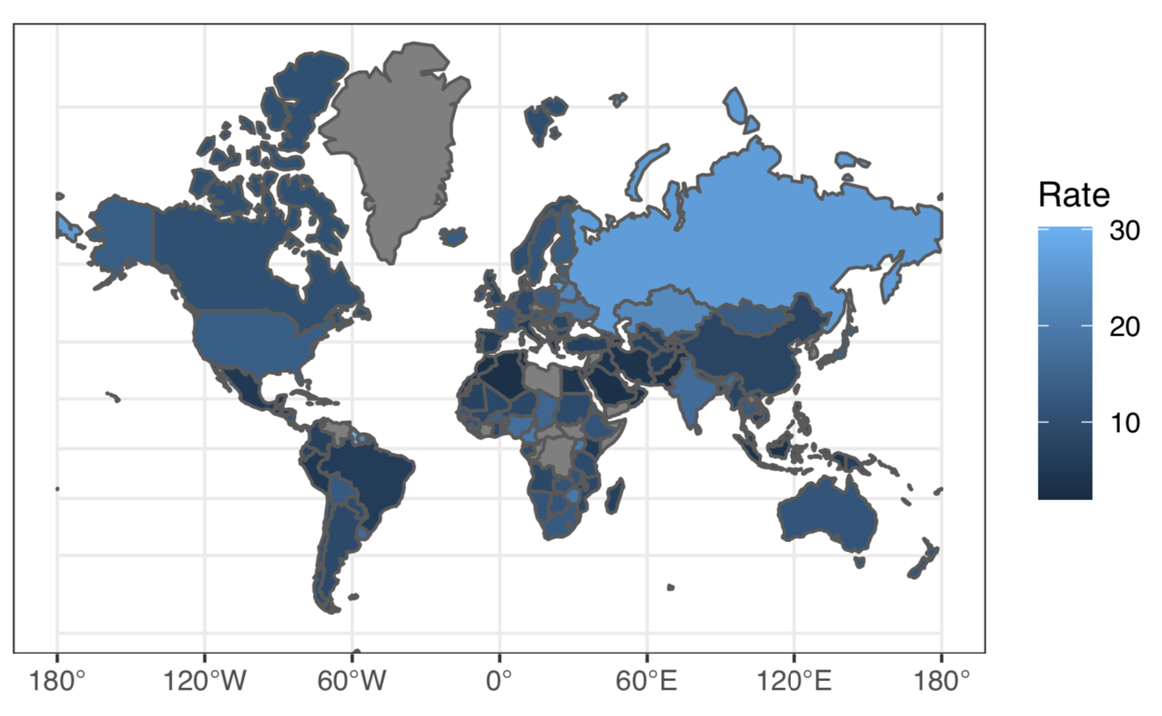
Suicide is a Global Problem With Significant Effects
Worldwide Suicide Rate by Country (per 100,000 persons)
Key Insights*
One person dies every 40 seconds from suicide
Suicide is the 2nd leading cause of death among persons 18-29
Only 38 governments worldwide have a national suicide prevention program
Sadly, many deaths attributed to suicide are preventable
*Sourced from the World Health Organization report: “Suicide: Key Facts, 2019”

Slide 2
Faltering GDP, Economic Instability & Poverty Contribute to Suicide in Zimbabwe
Africa: Suicide Rate by Country (per 100,000 persons)
Key Insights*
The WHO estimates that 19 persons per 100k take their own life deliberately in Zimbabwe (2019)
Zimbabwe has dealt with issues of endemic poverty, unemployment and hyperinflation for years which is often attributed to the policies of former dictator Robert Mugabe
Post Mugabe, Zimbabwe continues to deal with debt issues, difficulty attracting foreign investment, and currency instability which continue to contribute to systemic unemployment and poverty nationwide
*Sourced from the World Health Organization report: “Suicide: Key Facts, 2019” and the WorldBank Economic Profile of the Country of Zimbabwe

Slide 3
Model Specification

Slide 4
Remaining Input: Alcohol Consumption
Liters of Pure Alcohol Consumed per Capita per Year
Data gathered from World Health Organization’s (WHO) Substance Abuse Country Profiles
Harmful use of alcohol is among the major risk factors for suicide
Risk of suicidal ideation, suicidal attempts and completed suicide are each increased by 2–3 times among those with Alcohol Use Disorders (AUD)
A study published in The Lancet found that global alcohol consumption saw an increase of about 70% from 1990 to 2017, going from about 21 billion liters of pure alcohol to 35.7 billion liters of pure alcohol

Slide 5
Quantifying the Impact of Country Level Measures

Slide 6
Identifying, Describing and Monitoring Country Level Indicators Is Critical for Effect Decision Making Support
Providing Decision Support for Policy Makers
Topline
A basic model describing the relationships between country-level indicators and suicide rates can help quantify the impact of broad measures on suicide prevention and direct attention to the measures that correlate to country-level outcomes
Our intention is to provide some initial context and decision support for policy makers managing health related planning activities and priorities at the country level
Quantifying these high-level impacts on suicide at the country level is meant to provide preliminary guidance on what measures should be monitored in context of suicide prevention strategy
Identifying & Quantifying Measures and Indicators of Country Level Suicide Rates
Incorporating Domain Knowledge and Expertise of Subject Matter Experts
Data, and Insight Driven Feedback & Monitoring
Insight Gathering, Analysis and Support Policy Maker Decisions

Slide 7
Income, GDP per person: Quantifying Impact & Monitoring
Income vs. Expected Suicide Rate (per 100k Population)
Insights
Our model indicates the presence of a significant relationship between a measure of income (country-level GDP per person)
Countries with lower per person income, tend to have higher incidence of suicide when controlling for other variables in our model*, this is especially concerning for countries with extremely low income levels as illustrated in the plot here
Based on our estimates, an approximate 10% increase in income corresponds to a 2% decrease in suicide rate at the country level for the typical country
We recommend policy makers ensure that income and economic measures are part of the conversation when framing suicide prevention strategies at the nation level
Note: Expected country level suicide rate, with 95% confidence interval.
*Other variables controlled for include Liters of Alcohol Consumption, The Presence of a National Suicide Strategy Prevention Program, and the Female/Male Labor Participation Rate.

Slide 8
Alcohol Consumption: Quantifying Impact & Monitoring
Alcohol Consumption vs. Expected Suicide Rate (per 100k Population)
Insights
Our model indicates the presence of a significant relationship between a measure of alcohol consumption (liters per year)
Countries with higher levels of alcohol consumption income, tend to have higher incidence of suicide when controlling for other variables in our model*, this could potentially be related to the incidence of alcohol abuse which was not considered based on data availability
Based on our estimates, an approximate 4% increase in alcohol consumption corresponds to a 2% increase in suicide rate at the country level for the typical country (>4 liters per year)
We recommend policy makers monitor and consider implementing measures designed to mitigate the harmful use of alcohol as a means of reducing the rate of suicide
Alcohol consumption was the most impactful and significant indicator of country-level suicide rate in our analysis
Note: Expected country level suicide rate, with 95% confidence interval.
*Other variables controlled for include Income (GDP per person), The Presence of a National Suicide Strategy Prevention Program, and the Female/Male Labor Participation Rate.

Slide 9
The Presence of A National Suicide Strategy: Quantifying Impact & Monitoring
National Suicide Strategy vs. Expected Suicide Rate (per 100k Population)
Insights
Our model indicates the presence of a significant relationship between the presence of a national suicide prevention strategy
Our model indicates that countries that have put a national suicide prevention strategy in place, tend to have higher incidence of suicide rates overall
Based on our estimates, countries that have implemented a suicide prevention strategy have a 26% higher incidence of suicide nationally
However, to put this in context, it appears that the institution of a suicide prevention strategy by countries struggling with suicide prevention overall, including Guyana, Lithuania, Suriname, Belarus and South Korea are driving this estimate
We recommend monitoring the national implementation of suicide prevention strategies, and encourage researchers to continue to control for the impact of this measure, as it has a significant impact in describing our outcome of interest
Note: Expected country level suicide rate, with 95% confidence interval.
*Other variables controlled for include Income (GDP per person), Liters of Alcohol Consumed, and the Female/Male Labor Participation Rate.

Slide 10
Summary: Data, and Insight Driven Feedback & Monitoring for Decision Support
Identify Measures & Indicators
Our initial analysis indicates the presence of significant relationships that describe suicide at the country level
Implement Strategies to Quantify and Monitor
In order to effectively support decision makers, strategies to implement the collection and monitoring of data on these identified indicators is recommended in context of suicide prevention
Inform Policy Making Decisions
Data-driven insights provided by the indicators and measures highlighted in this analysis are only one facet of an informed policy decision making strategy
We recommend ongoing engagements between those collecting data, monitoring outcomes, and providing specific domain knowledge to support a holistic suicide prevention strategy
Income (GDP per person), Alcohol and substance abuse, as well as the presence of a national suicide strategy should be considered in context of policy decision making and support
Our analysis is intended to support a strategy for monitoring and collecting insights from data, subject matter experts should be engaged at all steps of a planning process

Slide 11
Conclusions & Appendix

Slide 12
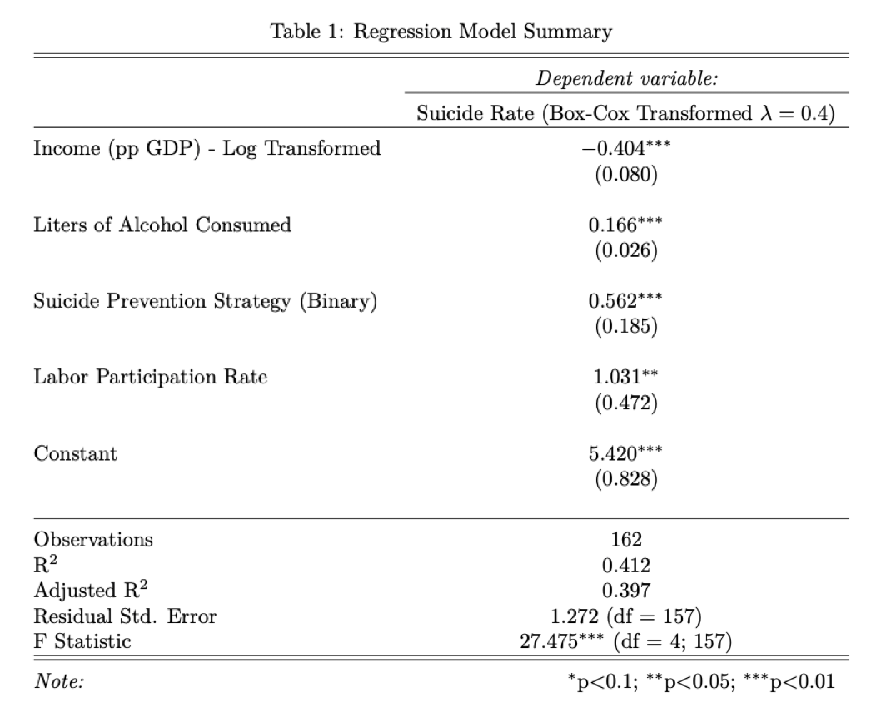
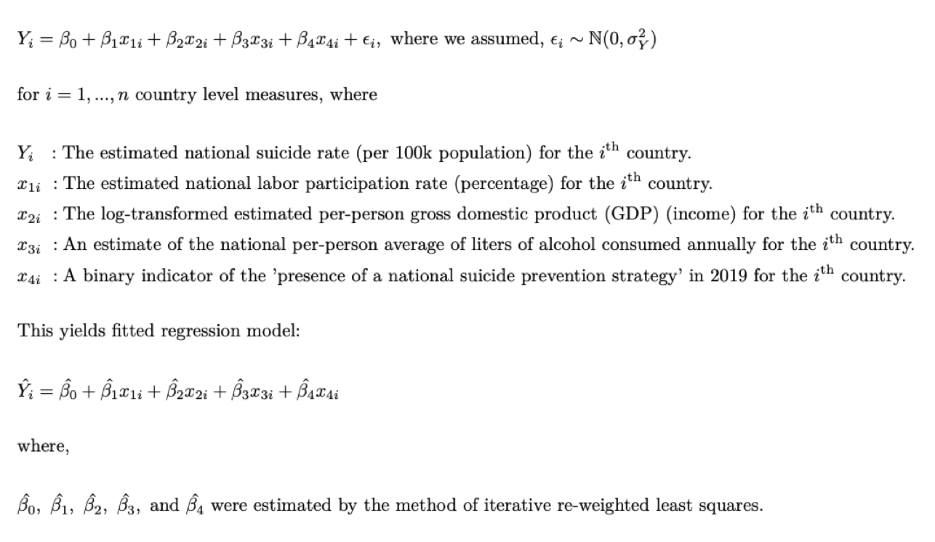
Final Model Specification & Model Results Summary
Model Specification
Model Estimates & Results

